Slide 1
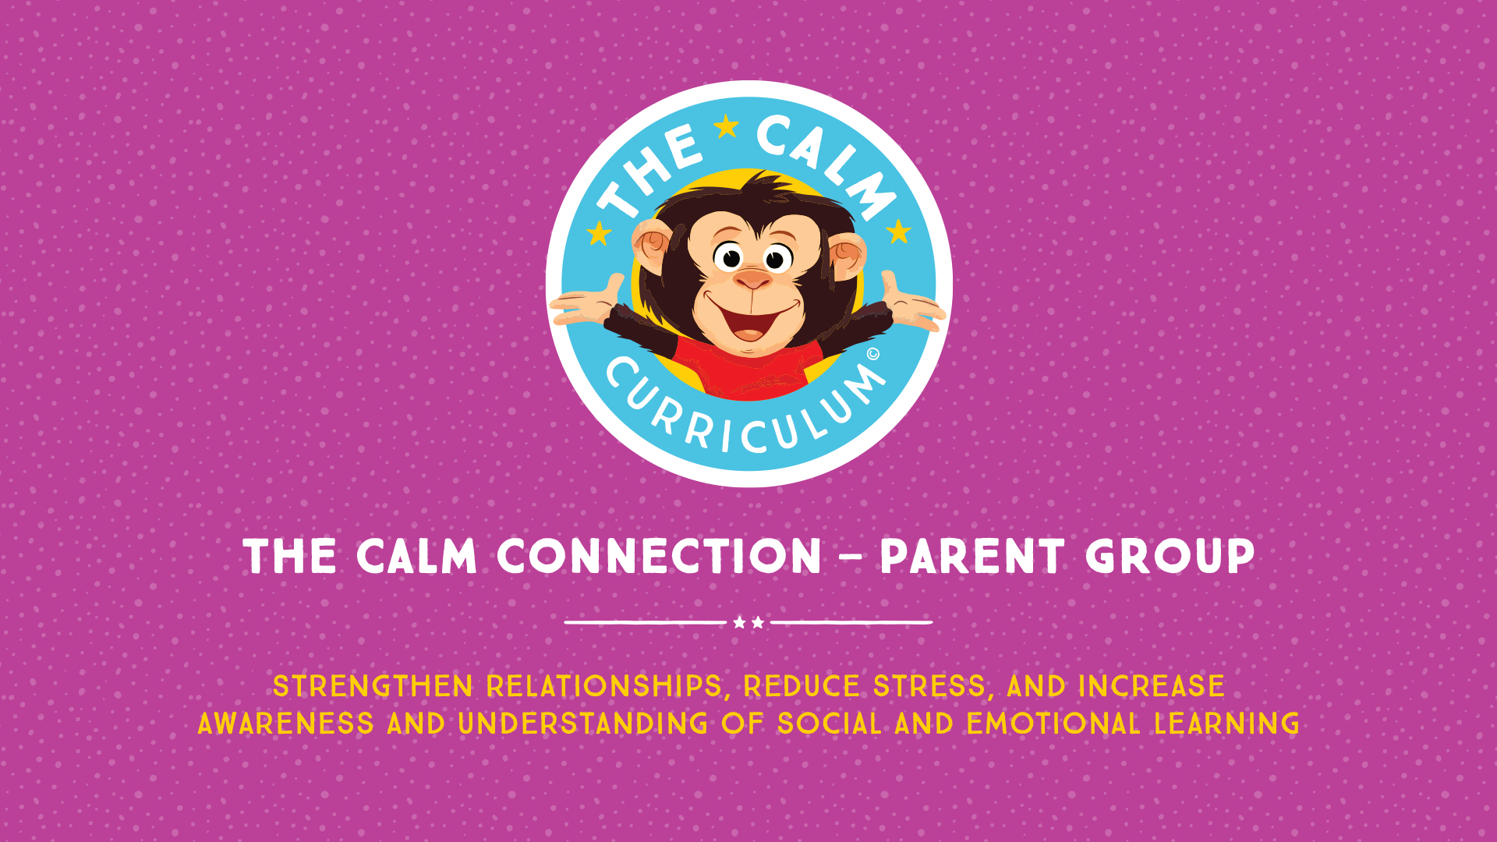

Slide 2

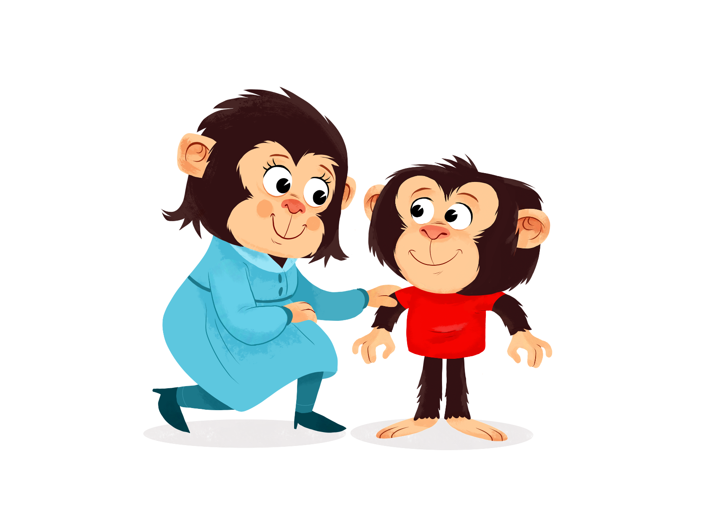
Introduction
Notes:
Greet participants as they enter the room and use the Melvin countdown strip to let participants know when you will start.
Thank you for taking the time to participate in this group. We know that your time is valuable and we appreciate you being here.
We truly want to create an environment where you feel safe to share and ask questions.
We know that sometimes due to the sensitive nature of some of the topics it may be hard to share your thoughts or concerns, so please do not hesitate to talk to one of the facilitators after the group.
Your children will be learning new skills with the educators in the other room. Today and every time we meet they will be supported through transitions using the countdown strip, which we will talk about at the end of this session. At the end of each session, we will send you home with the tools that your child was introduced to in their session. If your children are not participating in the group, we invite you to use these strategies at home.

Slide 3

Let’s get to know each other!
Notes:
Let’s start with some introductions. If we could go around and share your name, the ages of your child or children, and anything else you wish to share with the group.
After the introductions, the facilitators can introduce themselves and thank the group for sharing.
We just want to start with some group guidelines or, for lack of a better word, ‘rules’.
Facilitator Question: What would help you to feel safe in this group? Facilitators can write this down on flip chart paper to put up for every session.
Facilitator Question: What are you hoping to learn from attending this group? Facilitators write it down on flip chart paper.
We are going to be mindful of your learning priorities for this group and we will be addressing many of these topics in the six sessions.
We will revisit these on our last session and ensure that all your learning priorities were addressed.

Slide 4
May I have your attention… Please!
Notes:
Before we even start, we would like to draw your attention to this goldfish.
The goldfish is significant to a google Microsoft study in which the research was done to understand the adult attention span…are you worried yet?
According to the Microsoft Study, we have about 8 seconds to capture your attention, if in those 8 seconds you are not interested in what we have to say, your mind will begin to travel to other thoughts.
Perhaps you will start making your grocery list…….
or figuring out weekend plans……
or maybe you will think about all of the things you would rather be doing right now.
Now the significance of the goldfish is ………….if we were doing this presentation with a goldfish, we would have its initial attention span for 9 seconds!
CONTINUED NEXT PAGE…

Slide 5

Take a Breath!
Notes:
You 8 seconds and a goldfish 9 seconds.
Ok, take a breath…the study was debunked as scientists have not really been able to agree on goldfish attention span.
However, there is something critical we need to take out of this initial study and that is when it was originally done in the early 2000’s, your initial attention span was 12 seconds and now it is 8 seconds.…
We have lost 4 seconds in initial attention span! Let me count 4 seconds to you so we can feel how long this really is. 1….2….3….4
Now that may be something we want to be concerned about…
Facilitator Question: So, why do you think our attention span has decreased?
Possible Answers: Technology; Instant Gratification; Increased screen time…
Microsoft does claim good news, even though our attention has decreased, we have become better multitaskers in our heads. We need to wonder if this is good news.

Slide 6
The Uploading Screen ☹
Notes:
Let’s consider this slide.
How many of you see this on your computer and say….
“It’s okay, just take your time”.
“I don’t mind waiting”.
“I will just continue watching you go around and around.”
Or how many of you are like me and start clicking all the other keys and think….
“I don’t have time for this!”
Hard isn’t it.

Slide 7

Attention Span
Notes:
Understanding attention span is important for the marketing world. How often do you get distracted by the advertisements that pop up on your computer…usually something related to what you had previously searched.
Prezi, a software presentation company, conducted a survey (2018 State of Attention Report) to understand adult attention span, and what they concluded from the results was that you actually have a great attention span…. Especially when the content is interesting or you’re motivated to learn about it. Sound accurate?
How many of you have great attention span when you are watching Netflix?
So as we try to understand our children’s short attention span or need for instant gratification, we may have to agree that they are not the only ones that struggle with these skills, and they too, are far more motivated when the activity is interesting to them.
We will continue to do these types of reflections to help increase our own self-awareness and become more reflective of our own thoughts so that we can better understand our children when they are stressed.

Slide 8

Why Change?
How do you think your childhood experiences compare to the
experiences of children today?
Notes:
Let’s starts with some reflection……… and look at this question.
Facilitator Question: How do you think your childhood experiences are different from the ones your child is experiencing today?
(Give participants and opportunity to reflect and answer.)
Possible answers:
Increased technology
Children are playing less outside
Ask parents: When did you come inside when you were young? Wait for response
How many rules did you have when you were outside? Wait for response
Then ask….. How many rules do your children have today?

Slide 9
Why Change?
Notes:
Facilitator Comment: Just think about it, we got to run, jump, spin and meet all the energy needs of our body when we were younger. Our children still need to meet these energy needs and what happens when they run in the house, jump of the couch or spin in your living room?
Other possible answers:
Both parents are working
More children are in childcare
Communities or villages around our children have decreased…. More isolated parenting….parents feel judged.
More single parents

Slide 10
Why Change?
As a result,
should we be parenting
and caregiving differently?
Notes:
Research informs us that early experiences shape the architecture of the developing brain.
How your brain developed because of your childhood experiences will be different from how your child’s brain architecture is developing due to their experiences.
Facilitators Question: As a result, if our children’s brains are developing differently, should we be parenting our children differently?
Hold on to that thought!

Slide 11
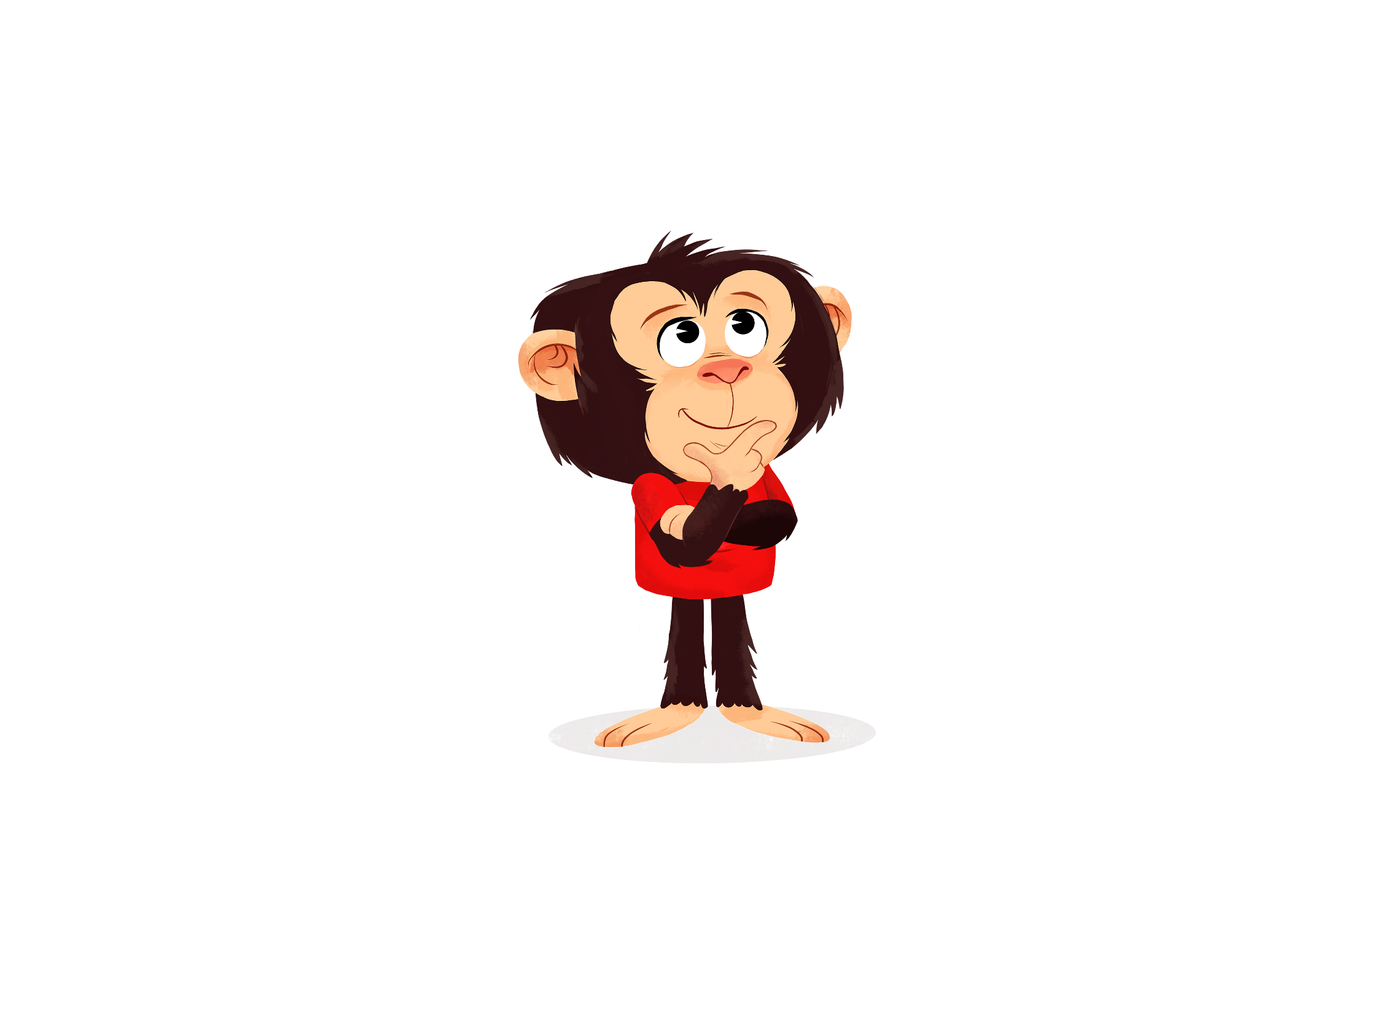
What about the Future?
What do you hope for your
children, 20 years from now?
Notes:
Facilitator Question: What do you want for your children 20 years from now? (Wait for responses and reflections)
No matter how many parents we ask, every parent answers similarly: We want our children to be happy, in good jobs, in healthy relationships and giving back to community.
Facilitator Question: How many of you want your children to have a connected relationship with you? (Wait for responses and reflections)
Developing the foundations of safe and connected relationships with your children when they are young will support children’s desire and motivation to stay connected as they get older.
Let’s hold on to these thoughts and start to examine if our values and beliefs even match all these great things that we want for our children in the future.
This next video will help us.

Slide 12
Video
You Tube (2010, July 9). I love Lucy: A Colorized Celebration - "Job Switching" clip
[Video file]. Retrieved from:
https://www.youtube.com/watch?v=K3axU2b0dDk
Notes:
Facilitator Question: So what kind of job are Lucy and Ethel doing in this video?
Yes, assembly or factory work. Not that there is anything wrong with this type of work but……
Facilitator Question: Will this work still exist for our children in the future?
Possible Answer: No, not really.
Facilitator Question: What has replaced this kind of work?
Possible Answer: Yes, machines or computers.

Slide 13
Why Change?
Let’s talk about where
schools came from…
Notes:
Now let’s talk about where schools came from…
Schools were originally developed during the industrial revolution when parents needed to work and we needed a place to house children.
School also had another purpose and that was to get children ready for jobs of the future……. Like factory work.
We needed children to learn skills to be able to follow and conform to strict rules, do rote types of work, make no mistakes, work in isolation, and so on.
Now for many of us….. our values and beliefs are still embedded in this type of old school mentality.
Let’s watch another video. We want to emphasize schools have changed in B.C. as a result of what you are going to see.

Slide 14
Why Change?
You Tube (2016, December 15). Next School,
6 Problems with our School System
[Video file]. Retrieved from:
https://www.youtube.com/watch?v=okpg-lVWLbE
Notes:
So we can see why our old school values are highly problematic…..
Especially when we look at recent studies from established educational institutions:
Harvard University, Stanford Research Institute and Carnegie Foundation found that when they interviewed employers of the future….
These values no longer match with what employers consider as the top 10 skills they were looking for in future employees:

Slide 15
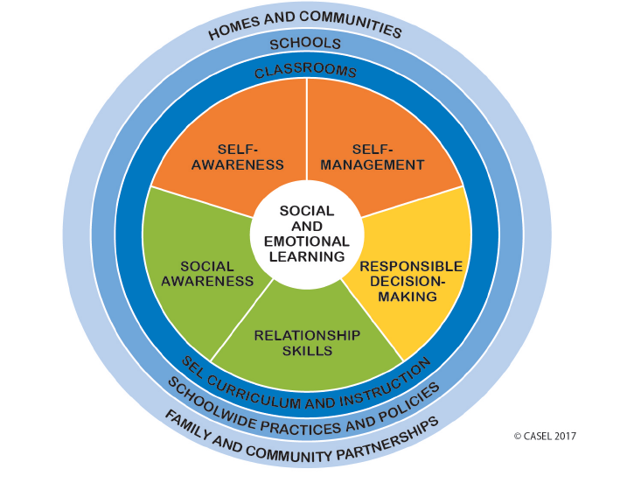
What Skills are Employers Looking For?
2020 | 2025
1. Complex Problem Solving | Analytical thinking and innovation
2. Critical Thinking | Active learning and learning strategies
3. Creativity | Complex problem-solving
4. People Management | Critical thinking and analysis
5. Coordinating with Others | Creativity, originality and initiative
6. Emotional Intelligence | Leadership and social influence
7. Judgement and Decision Making | Technology use, monitoring and control
8. Service Orientation 9. Negotiation 10. Cognitive Flexibility | Technology design and programming Resilience, stress tolerance and flexibility Reasoning; problem solving and ideation
Harvard University, Stanford Research Institute, Carnegie Foundation 2018
Notes:
As we can see from the top 10 list, many of these skills are people skills or soft skills which require a high competency in social and emotional skills.
Many of you may also be familiar, or have heard, that the B.C. Ministry of Education has embedded social and emotional learning skills into their curriculum outcomes as well.
Facilitator Question: Why?
Because they have been keeping current with the research and they know that students of the future will need…..
Critical and creative thinking skills,
Communication skills, and
Personal-social well being skills
These are necessary skills to be successful in the workforce in the future.

Slide 16
What does Job Success Look Like?
Technical skills and knowledge account for only 15%
of keeping and advancing in a job.
85% of your job success is connected to your people skills.
Research conducted by Harvard University, Carnegie Foundation, Stanford Research Institute
Notes:
We know that social and emotional skills are important foundational skills for our children to develop.
In fact, employers mention when considering promotions, they would promote based on an employees soft skills rather than technical skills because technical skills are easier to teach.

Slide 17

Emotional Intelligence
FACT:
Analytical intelligence (IQ) accounts for only 10% to 15% of job success and life success………85%-90% is dependent on
Emotional Intelligence (EQ).
Daniel Goleman, 2006
Notes:
Daniel Goleman, one of the leaders in understanding Emotional Intelligence states that only 10-15% of job and life success is dependent on IQ
and the other 85-90% is heavily weighted on our EQ or Emotional Intelligence.
Yet we continue to put so much emphasis on IQ.
We will be discussing different ways to support our children’s EQ in the next couple slides.

Slide 18
Emotional Intelligence
According to Daniel Goleman there are five elements
of emotional intelligence:
    Self- Awareness
    Self- Management
    Social Skills
    Empathy
    Motivation
Notes:
According to Daniel Goleman’s research there are five elements that we need to foster if we want our children to have a strong EQ…Self-Awareness, Self-Management, Social Skills, Empathy and Motivation.
So, how do our children learn these skills?
According to Dr. Dan Siegel, we learn emotional intelligence from our “Big People.”
YES that means you!
By the end of these six weeks, we are going to help increase your self-awareness, self-management and empathy skills, as well as ways that you can practice these skills with your child.
You already have many of these skills and we want you to become more aware of them so you can intentionally do more of them and model them for your child.

Slide 19
Children can Learn these Skills
We also know that we can support our children in developing social and emotional skills just like their
other developmental areas.
There are five areas of development.
Let’s consider how we respond to each of these learning areas as our children are developing new skills.
Notes:
Read slide.

Slide 20



Physical Development
Big and small muscle movement
Notes:
Let’s talk about a child’s Physical Development:
When children are learning to walk, or ride a bike and they fall……
Do we give them a time-out?
Facilitator Question: What do you do instead?
Possible Answers: Encourage, help, model…..

Slide 21

Communication
“I love pasgetti
too!”
“I love
basketti!”
Speech and language development
Notes:
What about Communication:
When your child says a word incorrectly………
Like Pasgetti instead of Spaghetti ……….
Do we yell at them and tell them they need to say it correctly?
Facilitator Question: What do you do instead?
Possible Answers: Encourage, help, model…..

Slide 22
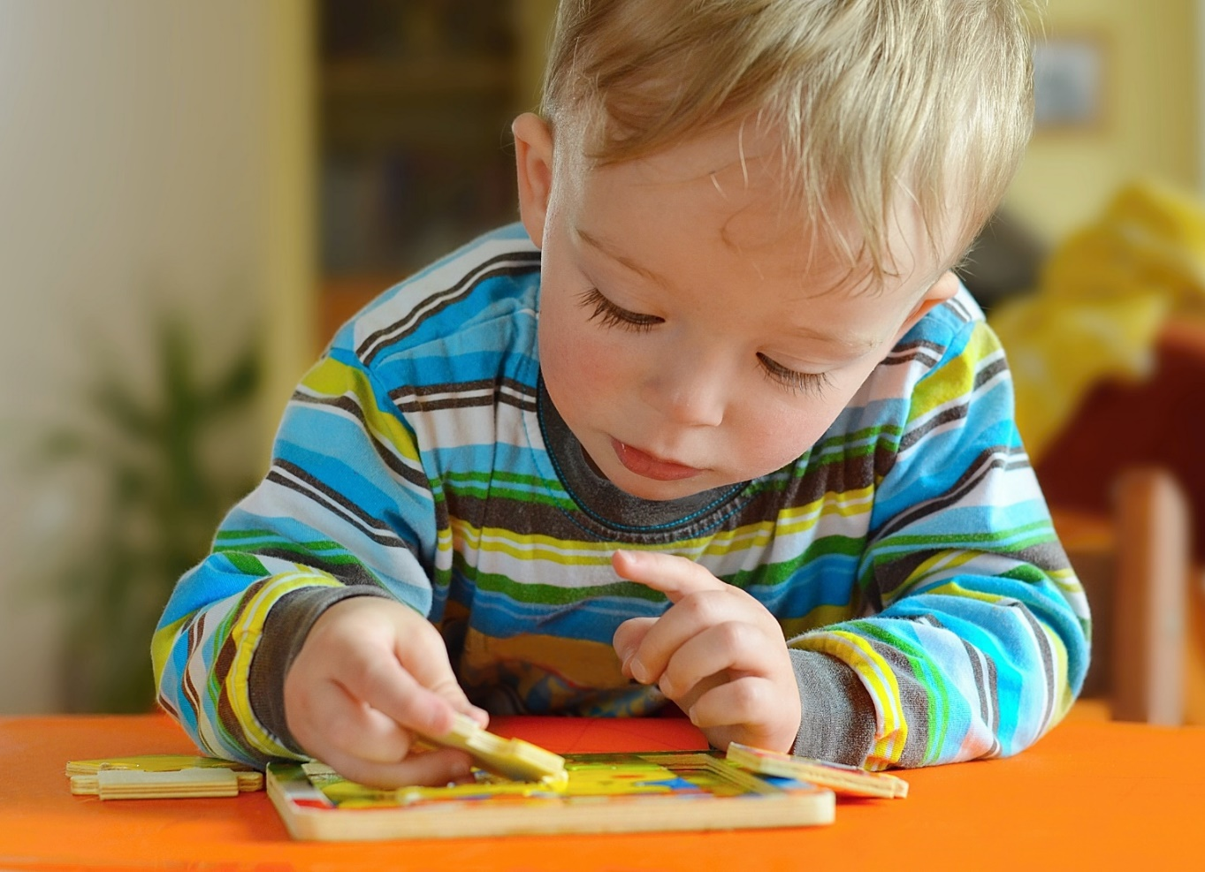
Cognitive Development
Thinking Skills
Notes:
What about when children are developing their Cognitive or Thinking Skills:
When children are thinking hard to figure out how something works, like fitting a puzzle piece into their puzzle……
Do we get angry that they are struggling?
Facilitator Question: What do you do instead?
Possible Answers: Encourage, help, model…..

Slide 23

Social Development
Interacting
with others
Notes:
Let’s look at Social Development:
When children are playing with others and your child takes a toy from another child…….
Do we punish them?
Put them on time-out?
Facilitator Question: What do you do instead?
Possible Answers: Encourage, help, model…..

Slide 24

Emotional Development
Recognize, express
and manage feelings
Notes:
Now let’s discuss children’s Emotional Development:
When your child screams and tries to hit you or says “I hate you”…….
Do we put them on a time-out?
Yell at them?
Facilitator Question: How would you respond?
Allow for discussion time here.
Do you notice how the first three skills of your child’s development, you can clearly identify as skills your child is learning.
Your child will have lots of frustrations and disappointments but for the most part, you are able to find supportive ways to foster and build the skill. Usually you are breaking it down for them into small, doable steps (scaffolding). CONTINUE NEXT PAGE………..

Slide 25

Won’t or CAN’T
They haven’t learnt the skill YET!
Notes:
The last two become harder…….
We might be penalizing our children for skills they just don’t have yet, instead of viewing these as skills our children need to learn. Try and remember what it feels like when you were learning to do something new or challenging…would you react well if someone yelled at you because you did not do it right or to their expectations….
This is going to be part of our learning journey. Together we are going to learn the difference between can’t and won’t when children are learning new skills.
Many times………..most of the time………………. Our child is not reacting because they don’t want to do something,
It is because they can’t ….. Because they have not learned how to do the skill in any other way.
The approach we will be learning is using supportive guidance to teach our children these skills, and ………… We will be moving away from penalizing our children for skills they haven’t learned yet!

Slide 26
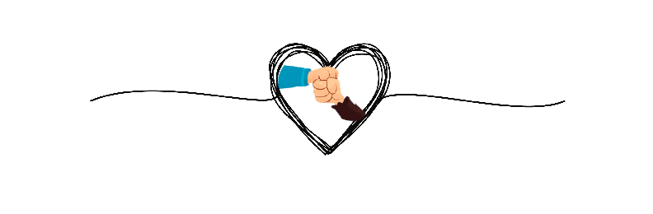
The Gift of the No Blame Zone…
Notes:
Every week we will go over this slide…….giving all of us the gift of the no blame zone.
As we learn together there may be times that you experience feelings of guilt. It is important to remember that these feelings are normal.
We need to remember that there is no such thing as perfect parenting. As parents we do the best we can with the information we know, we are human and we will make mistakes or we have never learned these skills. The gift of the no blame zone helps us from feeling shame or blame for the practices we do.

Slide 27
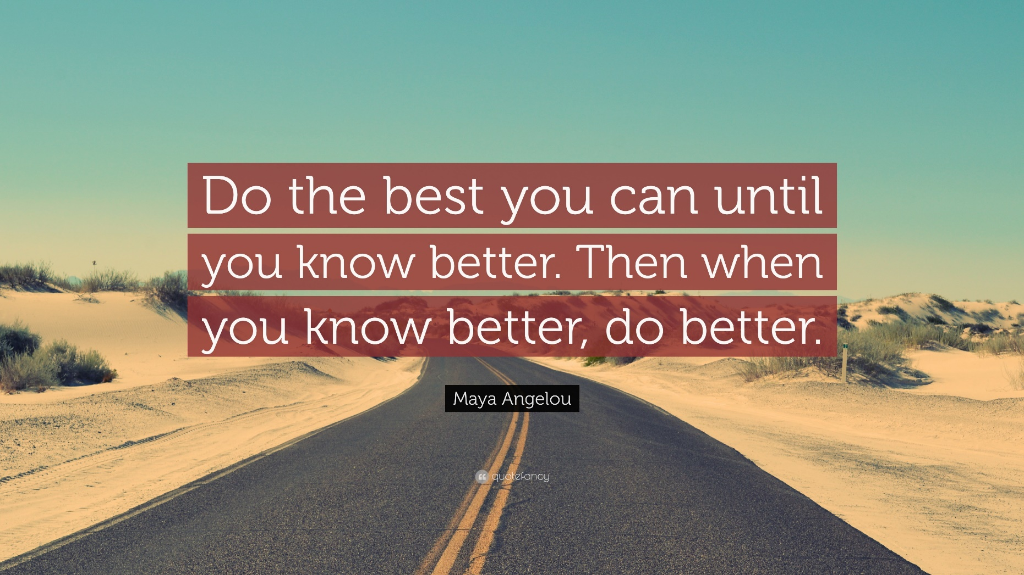
The Gift of the No Blame Zone…
Notes:
It is only when we know different that we can do different, and forgiving ourselves for the many mistakes we have made, and we will continue to make, as parents. Our children’s brains fully develop when they are 28+ years of age; therefore it is not too late to practice these new skills.
Also understanding that research states, if you can use the strategies that you will be learning (some of you are already doing) 30% of the time, it is enough to make connections with the neural pathways of your child’s brain to foster healthy brain architecture.

Slide 28
Let’s begin……….Session 1
Connect and Reflect
Interactions
Notes:
Facilitator Question: Are there any questions before we start session one?
This week we are going to learn about Connect and Reflect Interactions.
A simple concept, yet foundational in building the architecture of your child’s developing brain.
The good news is….. You are already doing this!
We are going to help increase your awareness of Connect and Reflect Interactions, and
help you become more intentional about doing it more often.

Slide 29

Connect and Reflect
Connect and Reflect can happen in your everyday routines and activities with your child.
Notes:
Harvard describes this like a tennis match and they refer to it as Serve and Return…. Basically they described it as when your child serves you an interaction, you would return your child’s serve with some sort of interaction. In the CALM Connection program we call this Connect and Reflect.
These types of interactions can happen regularly in your everyday routines and activities with your child. Think of when your child was an infant.
Facilitator Question: What did you do when your baby was crying… looked at someone, pointed at something?
Pause….Wait for response or give some examples.
In all these examples, your baby connected and you reflected on the interaction… The repetition of these connect and reflect interactions starts to build a healthy architecture for your child’s brain.

Slide 30

Connect and Reflect
Notes:
Very simply…..
Connect and Reflect is like a rhythmic dance between you and your child.
An example might be, your child may point at something and you might label what they are seeing.
This back and forth rhythm is where you are connecting with their interest and reflecting with curiousity.
It is a time when you are more than just physically present. You are now emotionally and mentally engaged with your child.
Let’s talk about what this can look like.

Slide 31

When I am Busy…
A Connect might be noticing your child by sharing what they are seeing, doing and feelings.
For example, they may be engaged in their favourite activity, such as creating a picture, and we would take time to notice.
Notes:
Connect and Reflect can happen at any time, even when our children are deeply engaged in their own activities. During this time it may be tempting as parents to do other things….. Laundry, make a meal etc.
It is important to take a moment to Connect and Reflect in what your child is seeing, doing and feeling, whenever you can. If your child is busy, you might lean over them and notice their activity and acknowledge, their work. For example saying, “you are using so many different colours in your picture.”
At times, even when our children are engaged in activities they may initiate connection with you, such as by saying “Look it!” They are excited for you to Connect with them and for you to Reflect on the work that they are creating.
This is when you might Reflect, “I see that you are using green and yellow for your picture.”
Taking these moments to be present, may reduce your child’s need to connect by using LOUDER ways to get your attention later.

Slide 32

Reflect Statements…
“Reflect” statements can help
you acknowledge your child.
“Connect” interactions are when you respond to your child.
Notes:
Remember a Connect interaction might be something your child says to you….. Points at……..Or they might just look up at you……
Consider all of these as an invitation for a Reflect statement.
Here are some Reflect statements that you can use with your child so they feel that you have Connected and they have been heard.
“You have been working on that picture for a long time.”
“I see that you are using lots of colours.”
“You have been working really hard on building your tower.”
“I think I am hearing you tell me that you want more books.”
“I am wondering if you are feeling hurt that Johnny took your red truck.”
“You are showing me how you put on your socks.”

Slide 33
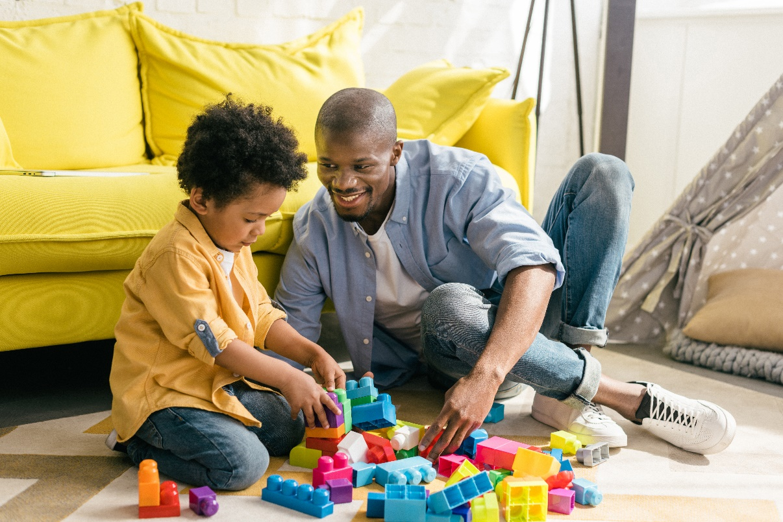
Reflect Statements….
“Reflection” statements help your child feel like they have been seen and heard.
Notes:
When using these types of reflections, your child feels like they are truly being heard and seen and often want to contribute more to the interaction.
It is no different than us adults. We want to be heard when we communicate.
Can you imagine sharing exciting news with someone you care about and they respond nodding their head or a simple, “Great work!”
We know reflections such as “good work”, or “good job” do not have a lot of meaning for children and adults and they often will end the interaction quickly. (We will talk more about this in another session)

Slide 34
WHY… is this Important
Connecting and Reflecting what our children are seeing, doing and feeling helps us to learn more about their interests and strengths.
They can also help us see where our children
may need some help.
Notes:
Many of you may already be thinking about the connect and reflect interactions you do with your child everyday, or perhaps you may be wondering how you may be able to do more of them in your day to day activities, learning how important these are for your child’s development.
Using this approach improves our relationship with our children, and also teaches them valuable social skills that they will carry with them into adolescence and beyond.
These interactions help you quickly figure out what your child is interested in and what their strengths are and,
you also learn areas where they may need you to give them a little help, or scaffold the skill.

Slide 35

When I Need Help…
Using reflection when your child needs help.
Notes:
Connecting with your child when they need help is also an example of a Connect and Reflect interaction that as a parent you often do unknowingly.
For example your child might try to connect with you by making a grunt or frustrated sound.
You might reflect by saying, “You sound like you are working hard”….or you might say, “You sound like you are getting frustrated.”
Your child might continue trying what they are doing and they might get more frustrated, and then they might ask for help or you might say,
“This is getting harder, I am seeing that you may need a little help.”
It is important not to complete or do the activity for your child, as you want to build their competence.
Helping your child, just a little, so that they can complete the skill successfully on their own is called “scaffolding”.
This is a very important way to help your child learn a new skill.

Slide 36
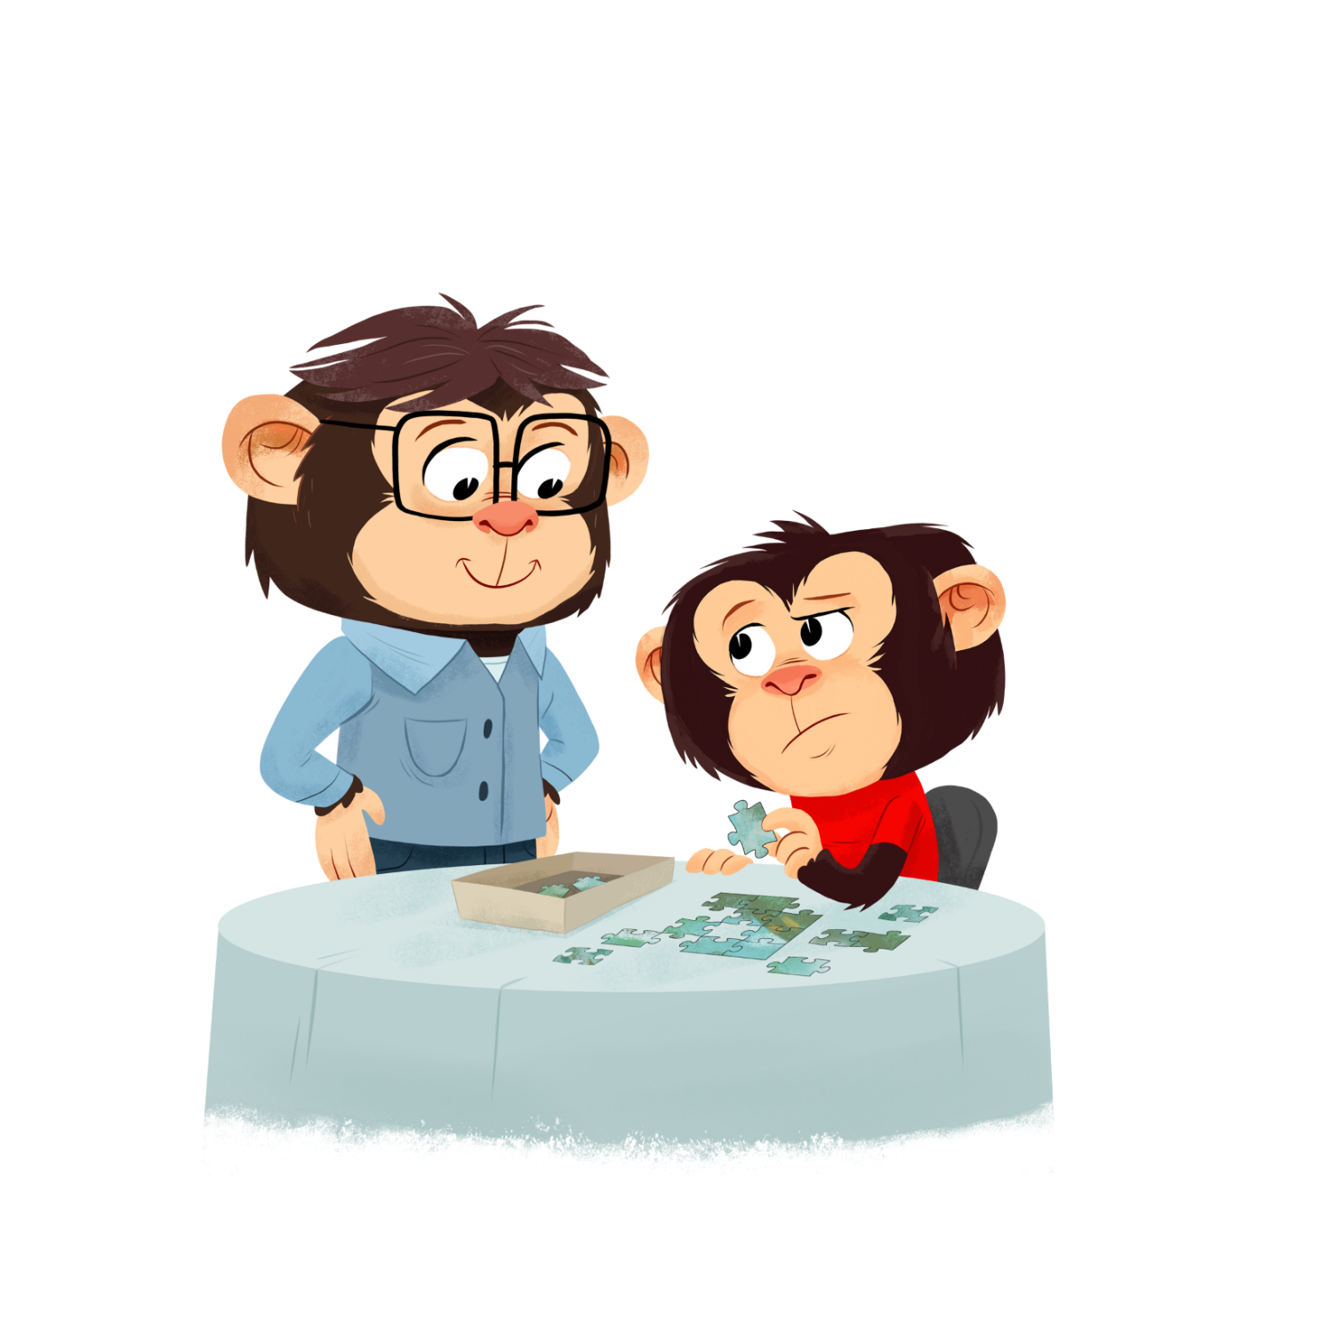
When I Need Help…
Using reflection to build new skills.
Notes:
Facilitator Question: Can you think of a time your parent taught you a skill?
We are starting to lose these type of scaffolding learning opportunities as children are now able to google the answers as they get older.
We really want to hold on to these as long as we can, and have our children come to us when they need help.
For example, if your child is trying to put the zipper up on their coat, and they look like they are getting frustrated.
Scaffolding would mean, you might help them put the zipper in the shank and you hold it, while your child pulls the zipper up.
Doing it this way allows your child to still feel mastery and competence in the skill and increases their confidence to do it again the next time they are putting on their coat.

Slide 37

Turn Taking…
Taking Turns and waiting helps your child learn self-control and how to get along with others.
Notes:
Connect and Reflect also helps our children learn important skills such as turn taking and waiting.
Taking turns requires that the interaction goes back and forth, such as communicating, I talk, then you talk, or when we are playing a game… My turn, now it is your turn.
Waiting helps your child learn self-control and how to get along with others. Waiting can be hard, even for us big people and for the most part, we are able to wait because we have had lots of practice.
Back and forth communication is a powerful way for children to learn the skills to wait and take turns.
During these interactions, it sometimes might take what seems like a long time for your child to respond; however, giving them this time will help your child learn self-control and attention.
These are critical skills to help your child get along with others.

Slide 38

Allow Time…
It may take your child 10-30 seconds to develop their idea.
Notes:
Research states that it may take your child 10-30 seconds to develop their idea and respond.
Your patience is necessary to help your child develop confidence and independence in coming up with their thoughts and ideas and having the time to respond.
Let’s see what 30 seconds feels like so we can understand how long it may take for your child to respond.
Activity: Use a timer and have everyone sit silently for 30 seconds
Facilitator Question: What did that feel like?
Once again, it may take time for your child to develop their idea and respond, and thanks to your patience, they will develop confidence and independence when you give them this time.

Slide 39
Limit Questions
Limiting the amount of questions we ask our children.
Notes:
This next one might be hard for all of us but a very good one for us to practice…. Limiting the amount of questions we ask our children.
When we ask too many questions it can contribute to our children feeling anxious and needing to come up with a specific response.
For example, you might ask your child, “What are you drawing?”
Your child may not know yet what they are making and they may feel like they need to provide you with some sort of final product answer.
Or asking a child, “How was school?” may be overwhelming to answer, just as someone might ask us how our day at work or at home was.
It might be easier to reflect on something with your child instead, for example,
If they have a piece of artwork in their hand, you can reflect by saying… “It looks like you did some art at school.”

Slide 40


Building a Better Brain Bank
Notes:
Although this may sound simple, the impacts of using Connect and Reflect are HUGE.
You are Building a Better Brain Bank Account for your child by engaging in these interactions.
Not only does Connect and Reflect help build skills such as communicating, waiting, self-control, BUT just as important, it is also building your child’s resilience to recover when you make a parenting mistake. Because it will happen, and you will make many.
By filling your child’s Better Brain Bank Account and making connect and reflect interaction deposits, it is an easier recovery when a withdrawal needs to be made.

Slide 41
Video
You Tube (2007).
Still Face Experiment: Dr. Edward Tronick
[Video file]. Retrieved from:
https://www.youtube.com/watch?v=apzXGEbZht0
Notes:
Warn parent that this is a hard video to watch.
Let’s watch this video. It is important to notice the signs of stress that our children may experience when their attempts to connect are unnoticed.
Watch the video BUT stop at minute 2:03:75.
Ask parents their thoughts on the video.
Facilitator: We can all find ourselves in these moments. It is important to become more aware of them.
My example: My 20 year old son, 18 year old daughter and I were going for a walk. Half way through the walk, I noticed my son engaged on his phone. I asked him if he was looking something up, and he replied, “I said Mom three times and you didn’t respond so I decided to go on my phone.” I was so caught up in my thoughts I didn’t even notice the ‘connect’. I apologised and explained that my thoughts were elsewhere.
Provide your example.

Slide 42
Let’s Practice
Notes:
Activity: Have the group break out into partners. If there is an odd amount of
participants, have one of the facilitators join the extra person.
Assign numbers to each pair, by numbering them one and two.
Alright, let’s have all the “one’s” share their most passionate dream, such as their dream vacation, dream day, dream car, dream yard, dream house etc.
All of the “two’s” will become extremely busy looking at their phone or distracted looking at other things.
We are going to do this for 45 seconds, and then we will switch roles.
Do Activity.
Let’s talk about what it felt like being in the role of the talker.
Facilitator Question: So, do you think our children may feel the same way…….
Allow for discussion.

Slide 43


Connect and Reflect
Notes:
As mentioned before, Connect and Reflect Interactions may already be happening between you and your child in different ways and for some you may be thinking about how to implement more of these in your daily activities.
Facilitator Question: How many of these connect and reflect activities sound familiar?
Cooing back to your baby
Responding to your baby/child’s cries
Singing with your child
Storytelling/Reading to your child
Playing Games such as Paddy Cake, Peek-A-Boo, Hide and Seek, Board Games, Card Games, I Spy
Child-Directed Play
You may be wondering what child-directed play is. Has anyone heard of this before?
Let’s quickly understand what this means together!

Slide 44
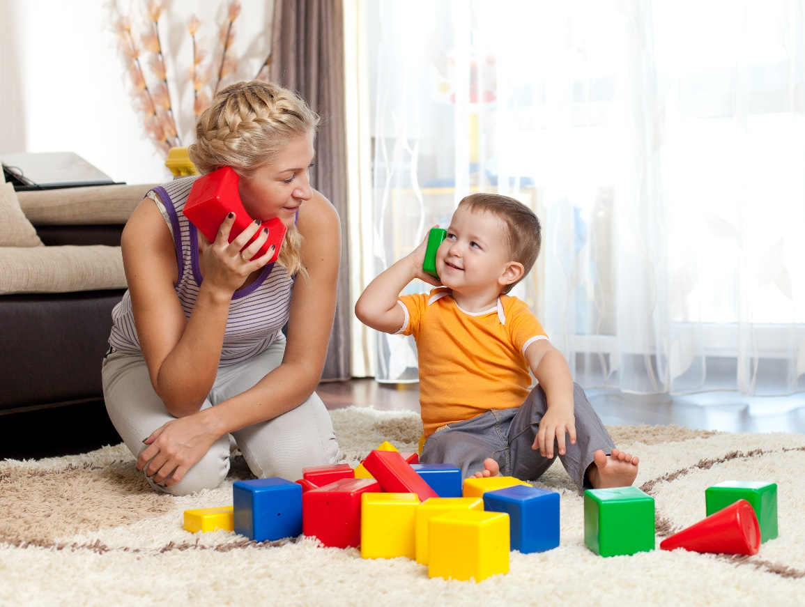
What is Child Directed Play?
Child-Directed play involves about 10-15 minutes of uninterrupted play with our child allowing them to take the lead and choosing the play activities.
Notes:
Child-Directed play involves about 10-15 minutes of uninterrupted play with your child allowing them to take the lead and choosing the play activities.
This type of play is essential in “filling up” your child’s connection and energy bank and helps build their better brain bank account.
A depleted connection bank makes it difficult for our children to be responsive, whereas when their connection bank is full, they are more likely to listen to you and engage in your activities because you have taken the time to show an interest and engage in their activities.

Slide 45

How To’s of Child Directed Play?
Your child will know that during this special playtime they will have your complete attention, where your are not distracted by the phone, other people, chores and you are emotionally available to them.
Notes:
Having a special name for this activity, such as
“Special Playtime” provides the child predictability of what this playtime means.
It also allows you to let them know that this time is coming later so that you can attend to other things, for example…..
“I know how much you want me to play with you and our special playtime will be happening after dinner.”
Your child will know that during this special playtime they will have your complete attention, where your are not distracted by the phone, other people, chores and you are emotionally available to them.

Slide 46
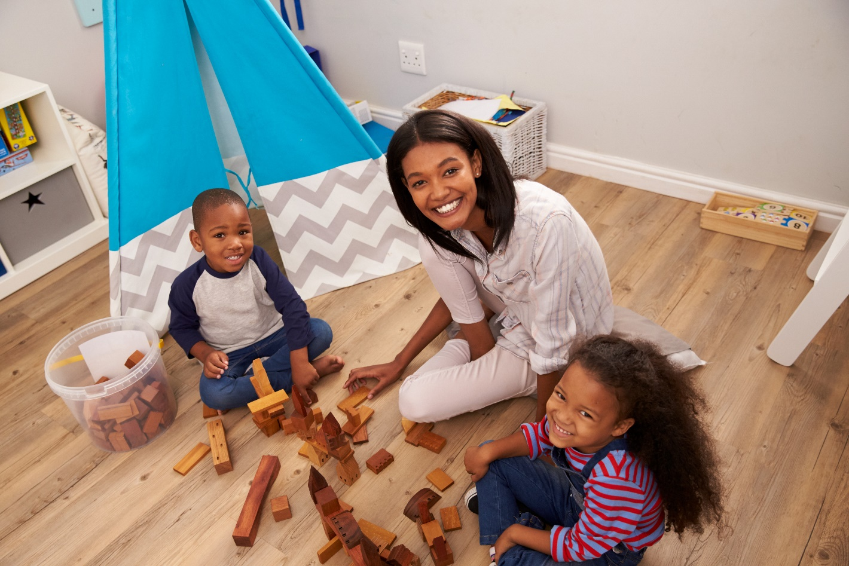
How To’s of Child Directed Play?
During this special playtime you are using all of your Connect and Reflect skills.
Notes:
During this play time, you are practicing your connect and reflect skills by observing and noticing what your child is doing and then reflecting on the play (just like a radio broadcaster),
“You are driving the red car into the blocks.”
Reflect on emotions as well,
“You look proud of the block tower you made.”
“You look sad that your block tower just fell down.”

Slide 47
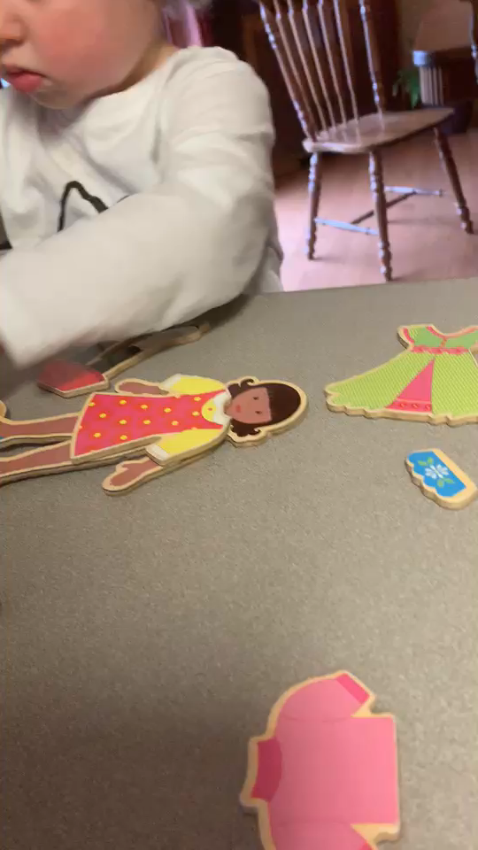
Child Directed Play
Notes:
Facilitator: What are some examples of the connect and reflect interactions that happened during this special playtime.
Possible responses:
Paraphrasing
“Blue dress” “Where do you want me to put the blue dress?”
Fun loud intonation "Beautiful”
“It does look like a bee doesn’t it”
“Cheese” Notice mom does not redirect her back to the play but takes interests into the cheese because that is what the child is noticing.

Slide 48
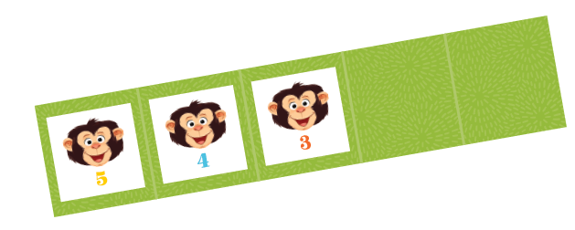
How To’s of Child Directed Play?
As your child will probably not want this special playtime to end, use the Melvin Countdown for a five minute warning before the play is going to come to an end.
Notes:
As your child will probably not want this special playtime to end, use the Melvin Countdown for a five minute warning before the play is going to come to an end. Children need time to prepare for closure.
As adults we need the right moment for closure. Can you imagine if someone turned off Netflix 5 minutes before the ending of your show, or took your book away from you when you were hoping to finish up the chapter?
It is hard for your children too, especially when it is an enjoyable activity. As a result, your child may argue for more time, and you would just calmly let them know,
“I know how much you enjoy this time and we will do it again soon.”
CONTINUED NEXT PAGE…..

Slide 49

How To’s of Child Directed Play?
Notes:
You do want to place some limits on this play to ensure that everyone is safe and materials/toys are used safely as well.
If your child is doing something that is not safe or will damage materials, in a calm soft voice, let them know the appropriate limits.
Use a calm patient voice to follow through on a limit… “The playdough will stick to the carpet, let’s move it to the floor.”
Keep the rules minimal and most importantly…HAVE FUN
Questions?

Slide 50
Homework…
Intentional Practice of Connect and Reflect Interactions
through everyday routines.
Sing, read books, and/or oral story telling.
Practicing 5-10 minutes of child-directed play.
Notes:
Yes…you have homework!!
We strongly invite you to practice and complete all of the homework exercises.
By practicing the skills you have learned during the group with your child in the upcoming week, you are able to reflect on them when we meet next week.
We want to know what you are finding easy to do and what was harder to practice.
Only when we know what is hard for you can we scaffold the skill for you so that you can learn how to do it successfully on your own…
Just like you would do for your child!!

Slide 51
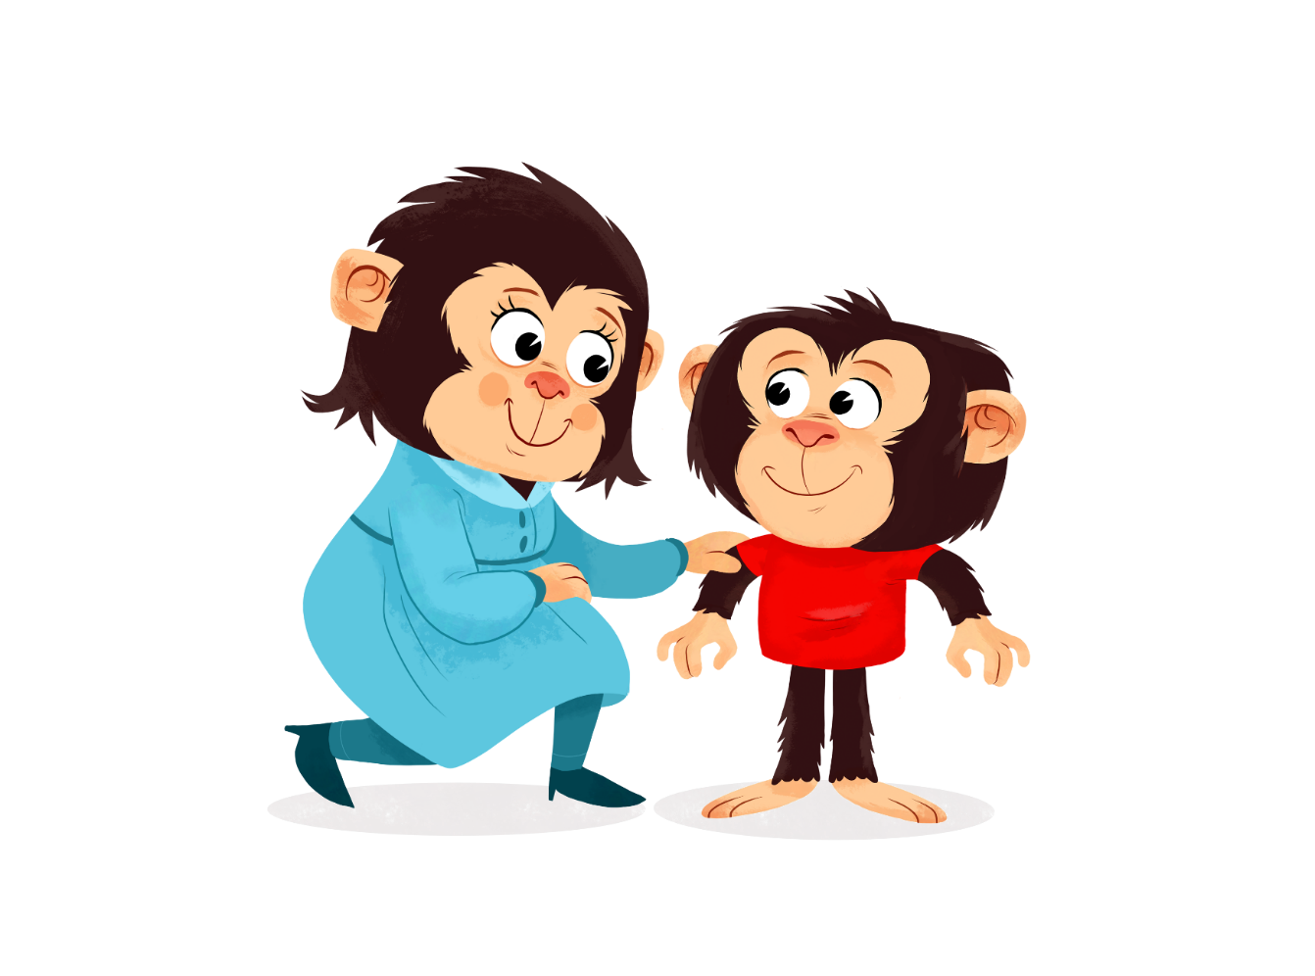
Self-Assessment…..Thank you!
Notes:
Please fill out the top part of the self-assessment sheet on Connect and Reflect Interactions.
This helps us know how we did with transferring the information to you.
At the end of the week, we will want you to fill out the practice piece to help us understand where you rate yourself on doing this skill in your everyday routines and activities.
We will collect these and give them back to you next week.

Slide 52
References: Module 1
Centre on the Developing Child at Harvard University (2021). 3 Principles to Improve
Outcomes for Children and Families. Retrieved from http://www.developingchildharvard.edu
Carnegie Foundation. (1918) A Study of Engineering Education, Charles Riborg Mann. pages 106-107.
Daniel Goleman, (2006) Emotional Intelligence: Why it can matter more than IQ
VIDEOS:
Slide 11: You Tube (2010, July 9). I love Lucy: A Colorized Celebration - "Job Switching" clip [Video file]. Retrieved from https://www.youtube.com/watch?v=K3axU2b0dD
Slide 13: You Tube (2016, December 15). 6 Problems with our School System [Video file]. Retrieved from: https://www.youtube.com/watch?v=okpg-lVWLbE
Slide 40: You Tube (2007). Still Face Experiment: Dr. Edward Tronick [Video file]. Retrieved from: https://www.youtube.com/watch?v=apzXGEbZht0
Slide 46: Permission Given, Fraser Valley Child Development Centre, G.Exley
IMAGES:
Slide 3: Vangert. Goldfish on White Background. Digital Image. Shutterstock. October 5, 2021. Retrieved from
https://www.shutterstock.com/image-photo/gold-fish-isolated-on-white-background-560580493
Slide 4: Microsoft study claims human attention span now lags behind goldfish. Digital Image. 2015, May 15. Retrieved from
https://medicalxpress.com/news/2015-05-Microsoft-human-attention-span-lags.html
Slide 5: 23Novembers. Laptop on table with loading bar load waiting on digital display, indicator concept. Digital Image. Shutterstock. June 3, 2021.
Retrieved from https://www.shutterstock.com/image-photo/laptop-on-table-loading-bar-load-563181544
Slide 6: Jamie Capria. Digital Image. Retrieved from https://fampay.in/blog/a-marketers-guide-to-moment-marketing/
Slide 7: 3-D Man.EU. A important question arises in the character. Digital Image. Shutterstock. June 3, 2021. Retrieved from
https://www.shutterstock.com/image-illustration/important-question-arises-character-141613780

Slide 53
References: Module 1
IMAGES: Continued
Slide 8: Anja W. Question mark 3d. Digital Image. Shutterstock. Retrieved from
https://www.shutterstock.com/image-illustration/question-mark-3d-man-people-interrogate-578984896
Slide 19: Monkey Business Images. Group Of Young Children Running Along Path In Autumn Forest. Digital Image. Shutterstock. October 11, 2019.
Retrieved from https://www.shutterstock.com/image-photo/group-young-children-running-along-path-388695901
Slide 19: Gundam, Ai. Attention Deficit Hyperactivity Disorder or ADHD children are practicing beads. Digital Image. Shutterstock.
October 11, 2019. Retrieved from
https://www.shutterstock.com/image-photo/attention-deficit-hyperactivity-disorder-adhd-children-334162937
Slide 20: Oksana Kuzmina. kids preschooler eating food in kindergarten or at home Digital Image. Shutterstock. October 11, 2019. Retrieved from
https://www.shutterstock.com/image-photo/kids-preschooler-eating-food-kindergarten-home-242983099
Slide 21: Sasenki. Little toddler doing puzzle. Digital Image. Shutterstock. December 9, 2021. Retrieved from
https://www.shutterstock.com/image-photo/little-toddler-doing-puzzle-boy-learns-618380708
Slide 22: Cheryl Casey. Young boy and girl fighting over bear. Digital Image. Shutterstock. October 11, 2019. Retrieved from
https://www.shutterstock.com/image-photo/young-boy-girl-fighting-over-bear-68621137
Slide 23: Fizkes. Shocked grandma closing ears. Digital Image. Shutterstock. October 11, 2019. Retrieved from
https://www.shutterstock.com/image-photo/shocked-grandma-closing-ears-not-hear-1231591498
Slide 24: Fizkes. Caring worried African American mother. Digital Image. Shutterstock. October 5, 2021. Retrieved from
https://www.shutterstock.com/image-photo/caring-worried-african-american-mother-holding-1417298627
Slide 25: Str33t Cat. Tangled grungy round scribble hand drawn with thin line, divider shape. Digital Image. Shutterstock. March 29, 2021. Retrieved from
https://www.shutterstock.com/image-vector/tangled-grungy-round-scribble-hand-drawn-1139800124
Slide 26: Maya Angelou. Digital Image. Retrieved from
https://quotefancy.com/quote/866192/Maya-Angelou-Do-the-best-you-can-until-you-know-better-Then-when-you-know-better-do
Slide 29: 4pm Production. I Love you Dad! Digital Image. Shutterstock. October 9, 2019. Retrieved from
https://www.shutterstock.com/image-photo/love-you-dad-handsome-young-man-1085099018
Slide 30: Tatiana Gordievskaia. Kids Paint Outdoors. Digital Image. Shutterstock. October 3, 2019. Retrieved from
https://www.shutterstock.com/image-photo/kids-paint-outdoors-portrait-child-girl-1420851536

Slide 54
References: Module 1
IMAGES Continued:
Slide 31: Angela Luchianiuc. Little daughter showing to mother something isolated on white, focus on baby. Digital Image. Shutterstock, October 3, 2019
Retrieved from https://www.shutterstock.com/image-photo/little-daughter-showing-mother-something-isolated-106791110
Slide 32: Lightfield Studios. Smiling african american father and little son playing with colorful blocks together at home. Digital Image. Shutterstock. October 3, 2019. Retrieved from https://www.shutterstock.com/image-photo/smiling-african-american-father-little-son-1078367516
Slide 34: Karelnoope. Close up portrait of crying little girl playing with wooden blocks at table. Digital Image. Shutterstock. October 3, 2019. Retrieved from
https://www.shutterstock.com/image-photo/close-portrait-crying-little-girl-playing-334700336
Slide 36: Vysek Images. Beautiful little son sitting on stairs holding and taking a picture to a dad. Digital Image. Shutterstock. October 3, 2019
Retrieved from https://www.shutterstock.com/image-photo/beautiful-little-son-sitting-on-stairs-1498736861
Slide 37: Oleg Golovnev. Skeptic. Portrait of Ponderer girl. Digital Image. Shutterstock. October 3, 2019. Retrieved from
https://www.shutterstock.com/image-photo/skeptic-portrait-ponderer-girl-102189820
Slide 38: Dizain. Question Mark. Digital Image. Shutterstock. July 17, 2019. Retrieved from
https://www.shutterstock.com/image-vector/question-mark-words-vector-concept-243224158
Slide 42: Monkey Business Images. Parents sitting with children reading story indoors. Digital Image. Shutterstock. October 9, 2019. Retrieved from
https://www.shutterstock.com/image-photo/parents-sitting-children-reading-story-indoors-114642343
MIA Studio. Happy Loving Family. Digital Image. Shutterstock. May 7, 2020. Retrieved from
https://www.shutterstock.com/image-photo/happy-loving-family-mother-baby-boy-1309043608
Slide 43: Oksana Kuzmina. Cute mother and kid boy playing together indoor. Digital Image. Shutterstock. October 9, 2019. Retrieved from https://www.shutterstock.com/image-photo/cute-mother-kid-boy-playing-together-103089908
Slide 44: Monkey Business Images. Young black boy playing. Digital Image. Shutterstock. October 9, 2019. Retrieved from
https://www.shutterstock.com/image-photo/young-black-boy-playing-on-back-557001508
Slide 45: Monkey Business Images. Mother And Children Playing With Building Blocks In Bedroom. Digital Image. Shutterstock. October 9, 2019. Retrieved from
https://www.shutterstock.com/image-photo/mother-children-playing-building-blocks-bedroom-627688985

